Slide 1
Measurement
What Is It and Why Do It?

Slide 2
Contents
What is measurement?
What are software metrics?

Slide 3
Measurement
Measurement is the process by which numbers or symbols are assigned to attributes of entities (objects) in the real world in such a way as to describe them according to defined rules.
Object = attributes {values}
Example:
Human = height 5’7’’ feet
weight 60 kg
Metrics are standards (i.e., commonly accepted scales) that define measurable attributes of entities, their units and their scopes.
Measure is a relation between an attribute and a measurement scale.

Slide 4
Why do we need Measurement?
Measurement in Everyday life:
Economic measurements determine price and pay increases.
Measurements in radar systems enable us to detect aircraft when direct vision is obscured.
Medical system measurements enable doctors to diagnose specific illnesses.
Measurements in atmospheric systems are the basis for weather prediction

Slide 5
Why do we need Measurement?
Measurement in Software life:
We measure characteristics of software to get some sense of whether the requirements are consistent and complete
whether the design is of high quality and
whether the code is ready to be released.

Slide 6
Is Measurement Simple to understand?
To understand what measurement is, we must ask a host of questions that are difficult to answer. For example
color is an attribute of a room. In a room with blue walls, is “blue” a measure of the color of the room?
attributes of people, such as intelligence, Does an IQ test score adequately measure intelligence?
wine can be measured in terms of alcohol content (“proof”), but can wine quality be measured using the ratings of experts?
the proposed measures of human intelligence or wine quality appear to have likely error margins. Is this a reason to reject them as bonafide measurements?

Slide 7
Is Measurement Simple to understand?
Which margin of error acceptable in measuring?
For example, we can obtain vastly diﬀerent measures for a person’s height, depending on whether the shoes being worn or the standing posture.
Which scale is acceptable?
For example, we can measure height in different scales.
miles and kilometers—appropriate for measuring the height of a satellite above the Earth,
inches, or feet, centimeter appropriate for measuring the height of a person.

Slide 8
Is Measurement Simple to understand?
Some engineers may claim important software attributes like dependability, quality, usability, and maintainability are simply not quantifiable.
But..
Businesses want to reduce the risk of product failures, late release of a product, loss of key employees, bankruptcy, etc.

Slide 9
Measurement
Measurement: A quantitatively expressed reduction of uncertainty based on one or more observations.
HUBBARD 2010, P. 23
Rule of Five:
There is a 93.75% chance that the median of a population is between the smallest and largest values in any random sample of five from the population.
Example: class method bodies are short. Take 5 samples; like 10, 15, 25, 45, and 50 lines of code.
There is 93.75% chance that the median of method bodies is between 10 and 50 LOC.
Notes:
This is a really neat heuristic because you can actually tell a lot from a sample size of 5! The median is the 50th percentile value of a population, the point where half of the population is above it and half of the population is below it. Hubbard points out the probability of picking a value above or below the median is 50% – the same as a coin toss. Thus, we can calculate that the probability of getting 5 heads in a row is 0.5^⁵ or 3.125%. This would be the same for getting 5 tails in a row. Then the probability of not getting all heads or all tails is (100 – (3.125+3.125)) or 93.75%. Thus, we can state that the chance of one value out of five being above the median and at least one value below the median is 93.75%.

Slide 10
Entity
An entity is an
object (such as a person or a room) or an
event (such as a journey or the testing phase of a software project)
in the real world.
An entity in software measurement can be any of the following:
Development Activity
Artifact (Specification, Design, Code, Test document)
Verification Activity
Resources (Tools)
Workforces (Person)

Slide 11
Attribute
An attribute is a feature or property of an entity
(e.g., blood pressure of a person, cost of a journey, duration of the software specification process)
There are two general types of attributes:
Internal attributes can be measured only based on the entity itself,
(e.g., entity: code, internal attribute: size, modularity, coupling)
External attributes can be measured only with respect to how the entity relates to its environment
(e.g., entity: code, external attribute: reliability, maintainability)

Slide 12
Identify:
Measuring physical entities:
Human height is 170 cm
E A V S
Measuring non-physical entities:
Human IQ based on IQ-Index 90
E A S V
SE metrics are mostly non-physical Reliability, maturity, portability, flexibility, maintainability, etc. and relations are unknown

Slide 13
Measurement Example
Entity | Attribute
Requirements | Size, Reuse, Redundancy
Specification | Size, Reuse, Redundancy
Design | Size, Reuse, Modularity, Cohesion, Coupling
Code | Size, Reuse, Modularity, Cohesion, Coupling, Complexity
Test Cases | Size, Coverage
Notes:
a requirement is something that is needed and that a specification is a precise description of an item. In the project management arena, the term requirement generally refers to a customer need while specification refers to a detailed, usually technical description of how that need will be met. For example, if an airline wants a plane that will fly 800 passengers from Los Angeles direct to Tokyo, that is a requirement; when the manufacturer designs an aircraft of certain dimensions powered by four engines of certain horsepower, that is a specification.

Slide 14
Measurement : Type
Measurements are needed as:
Descriptors of entities already in existence.
Prescriptors (standards, norms, failure intensity objectives, benchmarks) which entities of certain class or category should satisfy.
Predictors to estimate properties of entities yet to be designed or implemented.
First, measurement can help us to understand what is happening during development and maintenance.
Second, the measurement allows us to control what is happening in our projects.
Third, measurement encourages us to improve our processes and products.

Slide 15
Measurement : How to
In order to make entities measurable:
What entities (objects) should be selected?
What attributes should be selected?
What values should be assigned to the attributes?
What shall be the rules (relationships) ascribed to the attributes and their entities?

Slide 16
Example: Code
Entity: Code
Attribute: Size
Possible measures:
NCSLOC (Not Commented Source Lines of Code
#Statements
#Modules
#Classes
#Methods

Slide 17
Example: Availability
Entity: Availability
Attributes: system uptime, system downtime
Values: time in seconds
Relations:
Availability = uptime / (uptime + downtime)

Slide 18
Software Measurement
Software metrics are measures that are used to quantify software, software development resources, and/or the software development process.
This includes items which are directly measurable, such as lines of code, as well as items which are calculated from measurements, such as software quality.

Slide 19
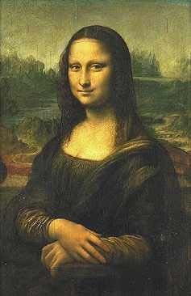

Software Measurement
Measurement in SE is selecting, measuring and putting together many different attributes of the software, and adding our subjective interpretations in order to get a whole picture of the software.
It is not a trivial task!

Slide 20
Measurement in SE
Before a measurement project can be planned
Objectives and scope should be established
Alternative solutions should be considered
Technical and management constraints should be identified.
This information is required to estimate costs, project tasks, and a project schedule.

Slide 21
Measurement in SE
In order to manage software measurement project one must understand and plan:
The goal and scope of work
Risks
Resources required
Tasks to be accomplished
Milestones to be tracked
Total costs of the project
Schedule to be followed

Slide 22
Measurement in SE
Software metrics help us understand the technical process that is used to develop a software product.
The process is measured to be improved.
The product is measured to increase its quality.
But …
Measuring software projects is controversial.
It is not yet clear which are the appropriate metrics for a software project or whether people, processes, or products can be compared using metrics.

Slide 23
Scope of Software Metrics
Cost and effort estimation
Productivity measures and models
Data collection
Quality models and measures
Reliability models
Performance evaluation and models
Structural and complexity metrics
Capability maturity assessment
Management by metrics
Evaluation of methods and tools

Slide 24
Example 1
We are going to buy a new color laser printer for our department. We have borrowed the printer for the test.
Maker’s data shows that we need to change the toner every 10,000 pages. We would like to have only one failure during the period.
During test period, we observe that failures occur at 4,000 pages, 6,000 pages, 10,000 pages, 11,000 pages, 12,000 pages and 15,000 pages of output.
What can we conclude about this printer?

Slide 25
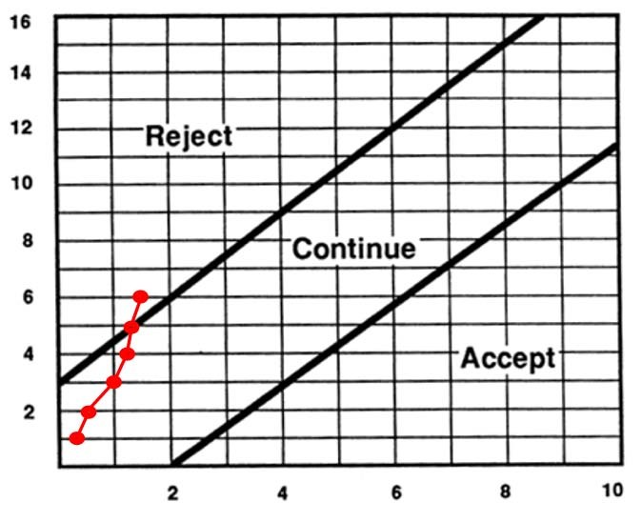
Example 1
Failure intensity objective:
λF = 1/10000 pages
Using Reliability demonstration chart we can conclude that the printer must be rejected.
Failure number
Measurement unit

Slide 26
Example 2
We are going to initiate a new game and video on-demand download service. The service is provided to the customers who own PCs and register with the service.
The customers must use specialized software to download games or videos from the server. The failure intensity of the software is 1 failure per 100 CPU hr. On average, the specialized software system runs 20 CPU hr per week on each client machine and there are 800 customers to be serviced.
We would like to provide the customers with an on-site repair service. Each serviceperson can make 4 service calls per day. Service personnel are available 5 working days per week.
How many service personnel do we need to hire?

Slide 27
Example 2
How many service personnel do we need?
Using the value for failure intensity, each system experiences 0.2 failure per 20 hours of operation or 0.2 failure per week, on average.
The total failures for 800 customers is 160 per week or 32 per day.
Each serviceperson can visit 4 sites per day, therefore, the number of required personnel is 32 / 4 = 8.

